Slide 1
Object Oriented Programming using JAVA Paper code: PCC – CS481
Presented By
Sudeshna Kundu (Mondal)
Mobile No. : 9564842816

Slide 2
Book
Java - The Complete Reference,
Author – Herbert Schildt
Latest Edition – 11th Edition
Publisher – McGraw Hill Education

Slide 3
Evolution of OOP
Machine language
0 1 1 0 1 1 0
Assembly Language
MOV A, B
High Level Language
Procedural Programming Approach
C, PASCAL
Object Oriented Programming Approach
C++, JAVA

Slide 4
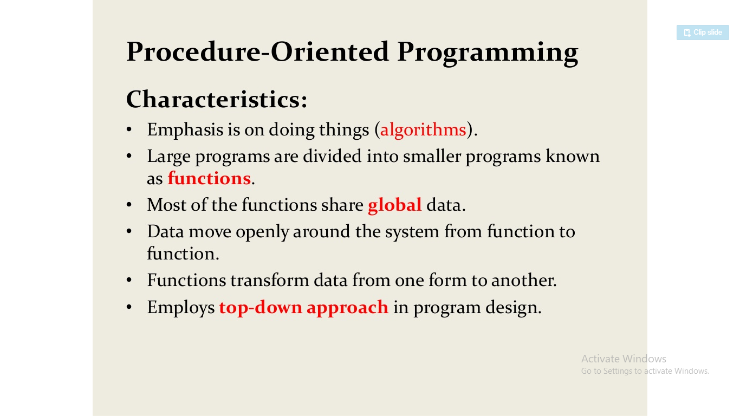
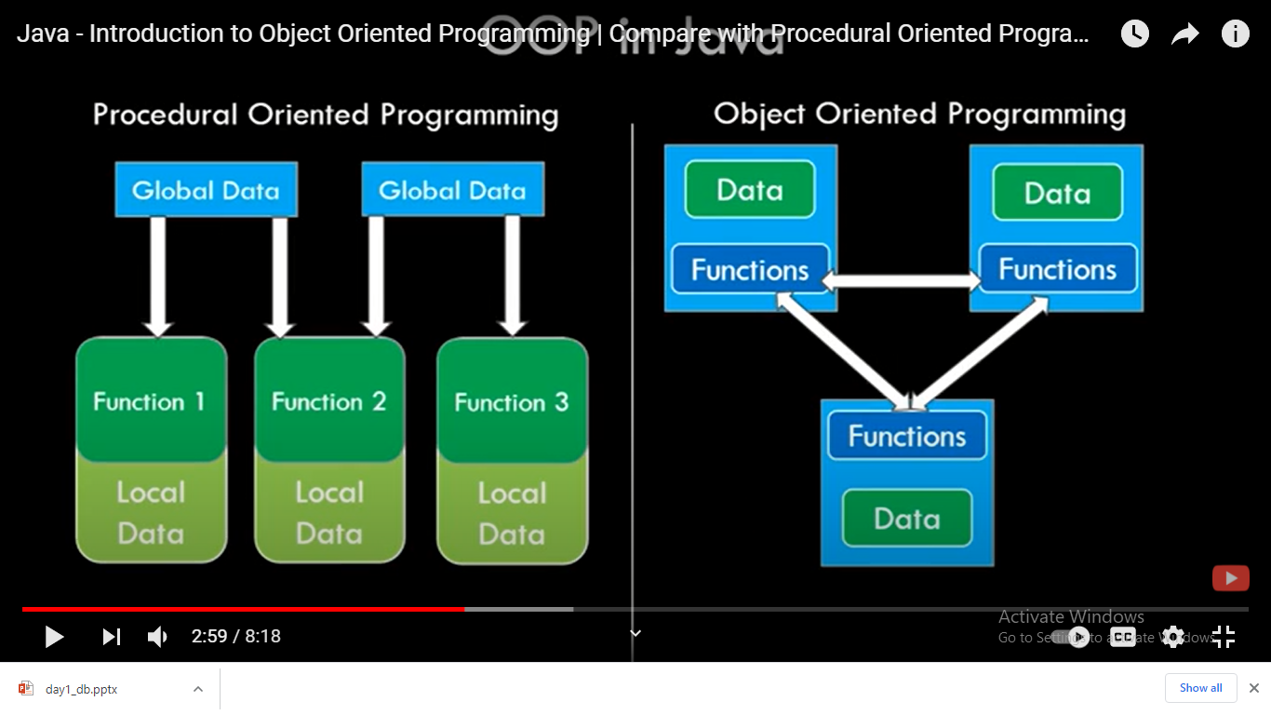

Slide 5
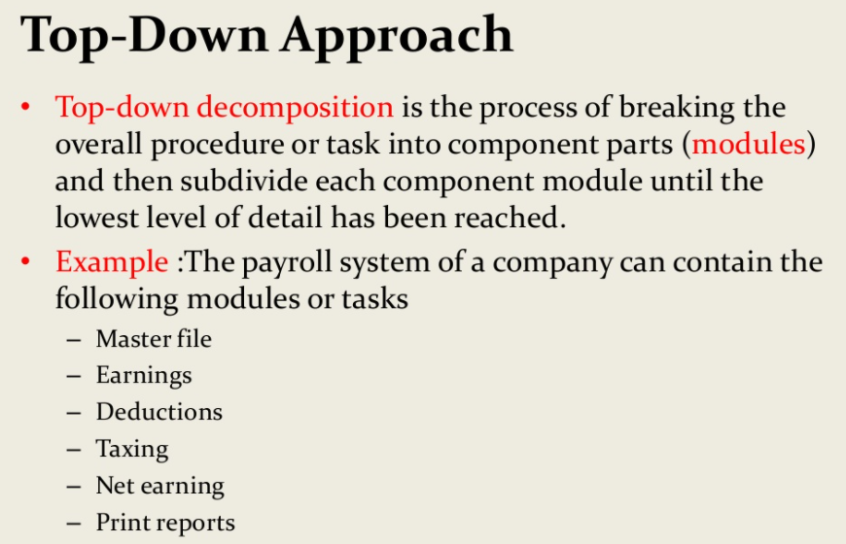

Slide 6
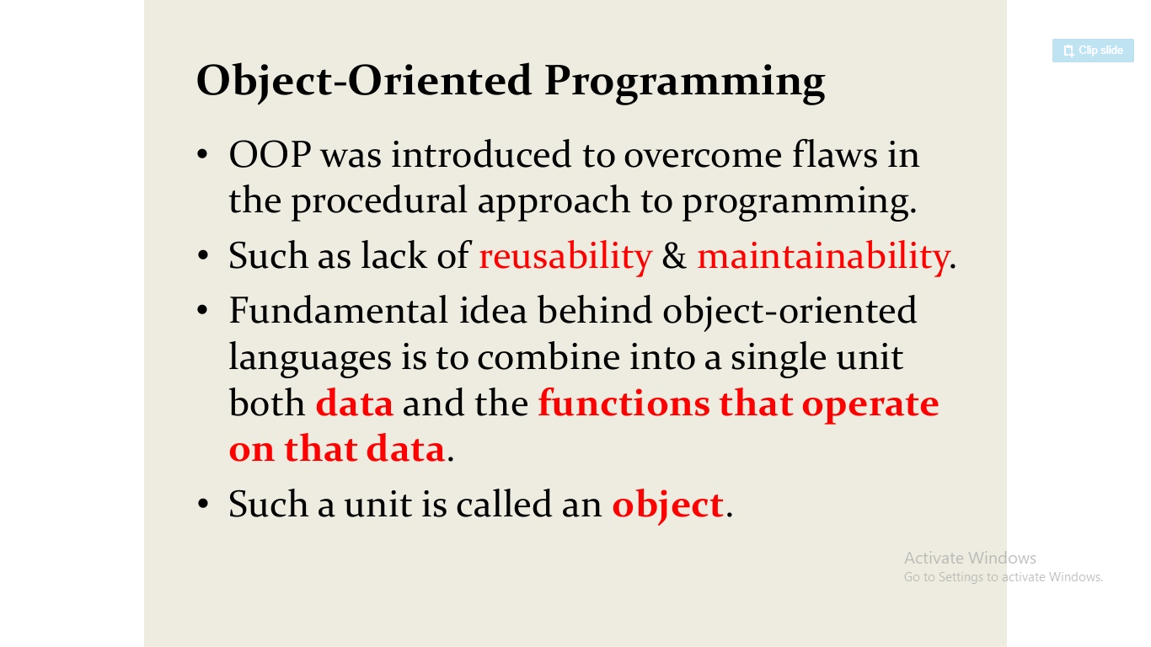
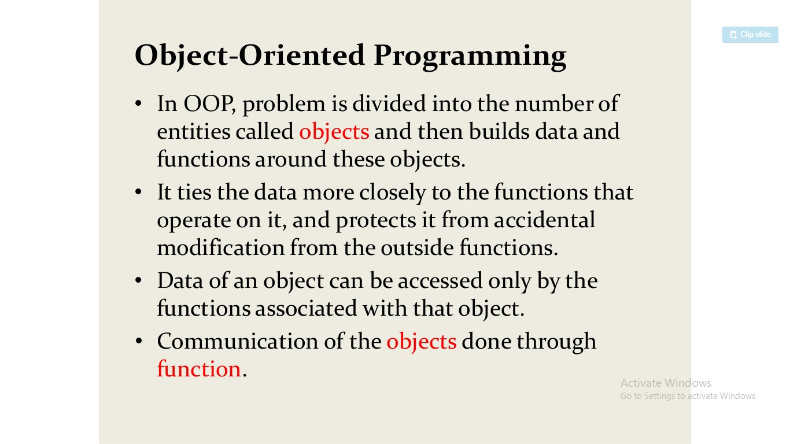

Slide 7
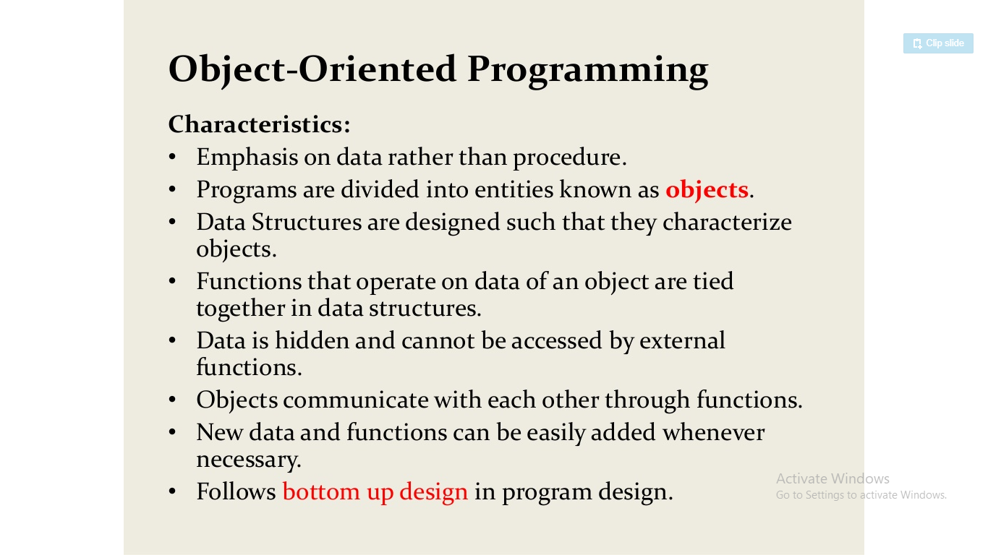

Slide 8
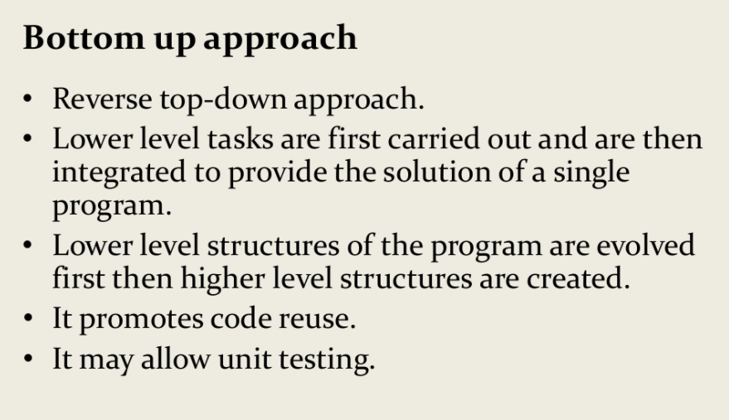

Slide 9
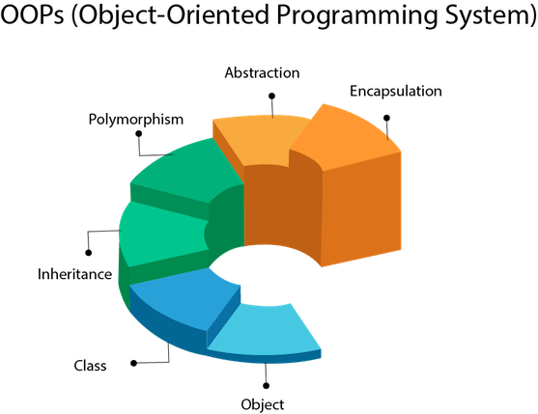
Object Oriented Programming (OOP)
Object-Oriented Programming is a methodology or paradigm to design a program using classes and objects. It simplifies the software development and maintenance by providing some concepts:
Object
Class
Inheritance
Polymorphism
Abstraction
Encapsulation

Slide 10
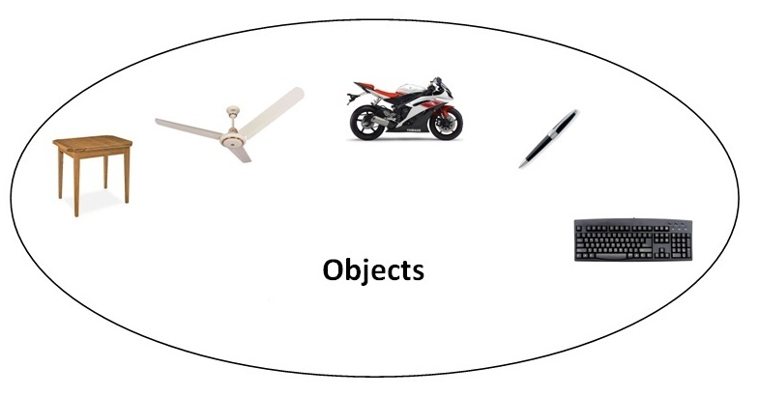
Object Oriented Programming (OOP) Features:
Object
Any entity that has state and behavior is known as an object. For example: chair, pen, table, keyboard, bike etc. It can be physical and logical.
An Object can be defined as an instance of a class. An object contains an address and takes up some space in memory.
Objects can communicate without knowing the details of each other's data or code. The only necessary thing is the type of message accepted and the type of response returned by the objects.
Example: A dog is an object because it has states like color, name, breed, etc. as well as behaviors like wagging the tail, barking, eating, etc.

Slide 11
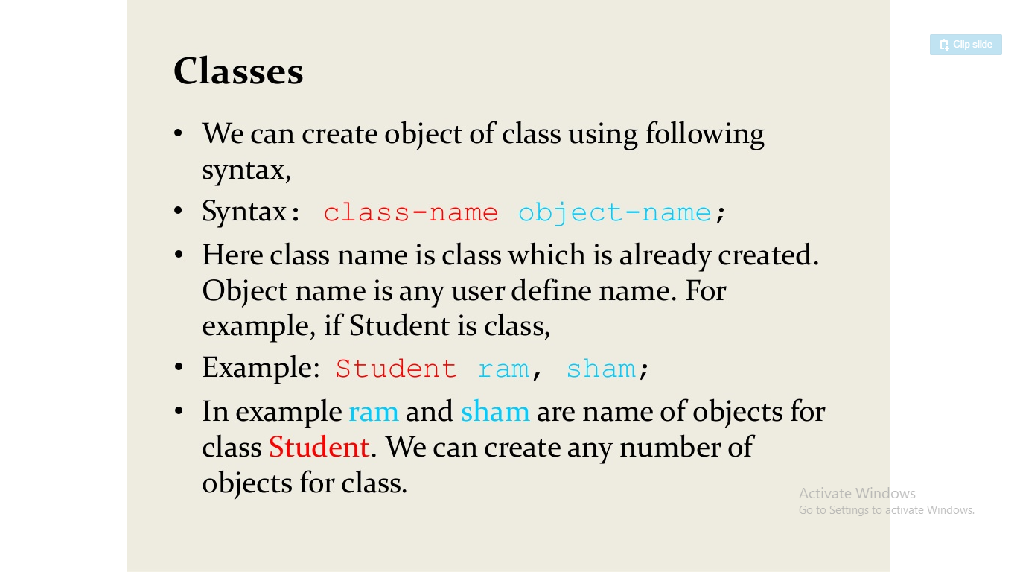
Object Oriented Programming (OOP) Features:
Class
A class is a user defined blueprint or prototype from which objects are created. It represents the set of properties or methods that are common to all objects of one type. It is a logical entity.
Class Student
State/ Attributes
Name
Roll No
Student 1
Behaviors
Student 2
displayDetails ()

Slide 12
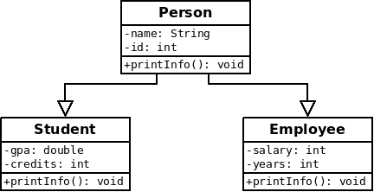
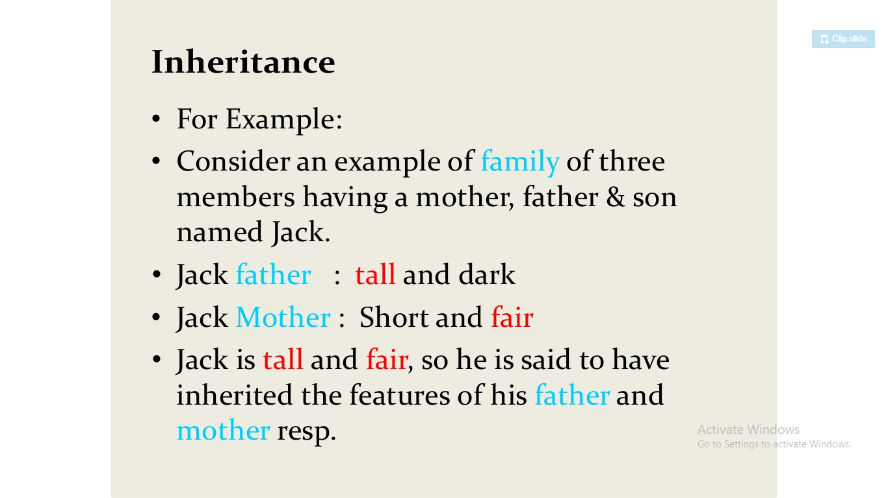
Object Oriented Programming (OOP) Features:
Inheritance
When one object acquires all the properties and behaviors of parent object i.e. known as inheritance. It provides code reusability.

Slide 13
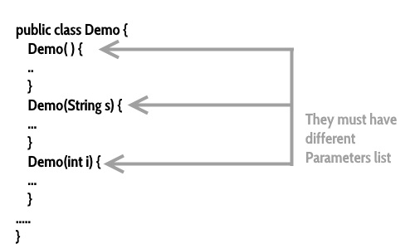
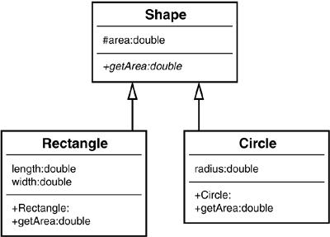
Object Oriented Programming (OOP) Features:
Polymorphism
Polymorphism is the ability of an object to one task is performed by different ways. For example: to draw something e.g. shape or rectangle etc.
In java, we use method overloading and method overriding to achieve polymorphism.

Slide 14

Object Oriented Programming (OOP) Features:
Abstraction
Hiding internal details and showing functionality is known as abstraction. For example: phone call, we don't know the internal processing.
In java, we use abstract class and interface to achieve abstraction.

Slide 15
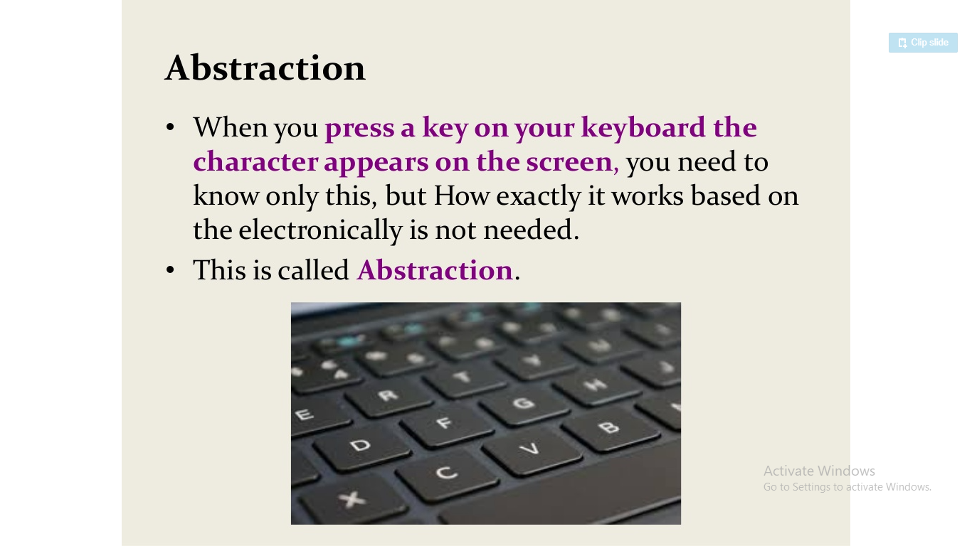
Object Oriented Programming (OOP) Features:
Abstraction

Slide 16
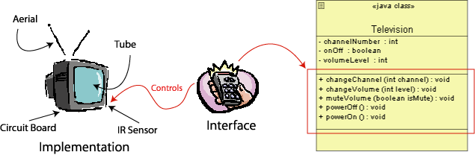
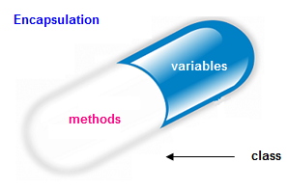
Object Oriented Programming (OOP) Features:
Encapsulation
Binding (or wrapping) code and data together into a single unit is known as encapsulation. For example: capsule, it is wrapped with different medicines.
It provides you the control over the data by declaring the variables of a class as private.
Provide public setter and getter methods to modify and view the variables values.

Slide 17
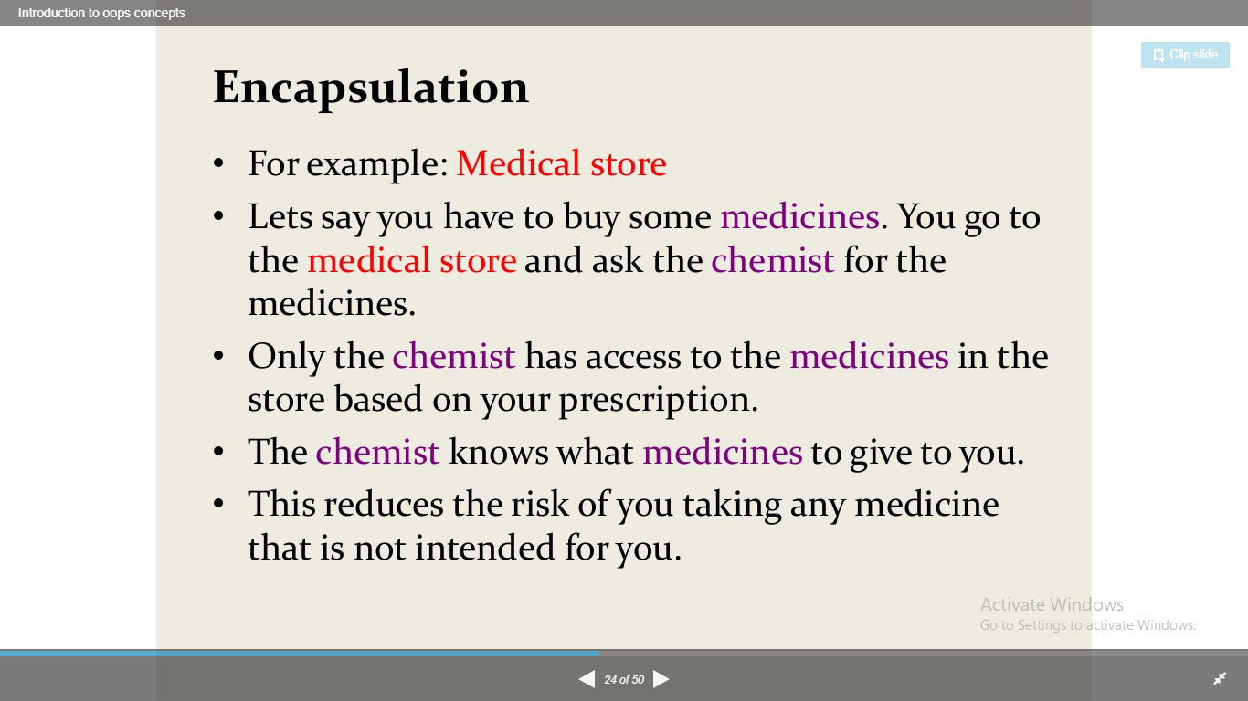
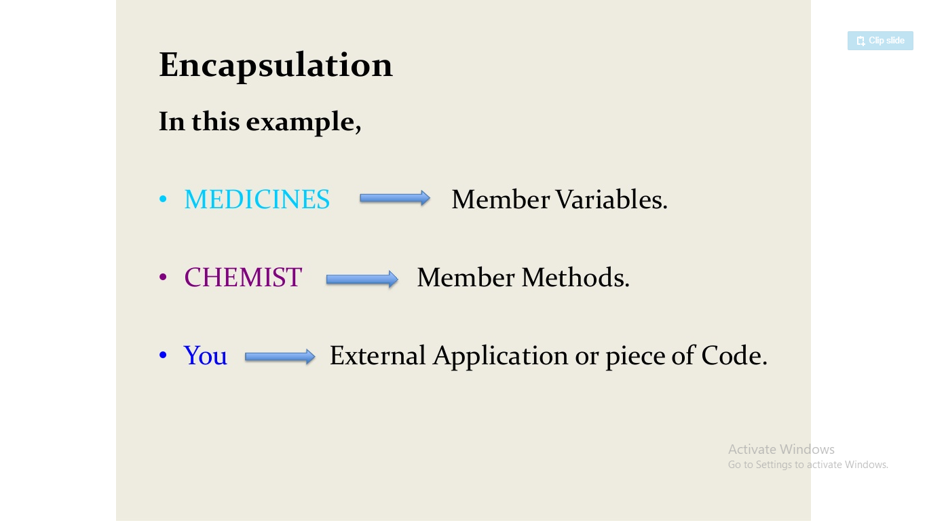
Object Oriented Programming (OOP) Features:
Encapsulation

Slide 18
Difference Between Procedure Oriented Programming (POP) & Object Oriented Programming (OOP)
Procedure Oriented Programming | Object Oriented Programming
In POP, program is divided into small parts called functions. | In OOP, program is divided into parts called objects.
In POP, Importance is not given to data but to functions as well as sequence of actions to be done. | In OOP, Importance is given to the data rather than procedures or functions because it works as a real world.
POP follows Top Down approach. | OOP follows Bottom Up approach.
POP does not have any access specifier. | OOP has access specifiers named Public, Private, Protected, etc.
POP does not have any proper way for hiding data so it is less secure. | OOP provides Data Hiding so provides more security.
In POP, Overloading is not possible. | In OOP, overloading is possible in the form of Function Overloading and Operator Overloading.
Example of POP are : C, VB, FORTRAN, Pascal. | Example of OOP are : C++, JAVA, VB.NET,

Slide 19
What is Java
Java is a programming language and a platform. Java is a high level, robust, object-oriented and secure programming language.
Java - The new programming language developed by Sun Microsystems (which is now the subsidiary of Oracle) in the year 1995. James Gosling is known as the father of Java. Before Java, its name was Oak.
Originally called Oak by James Gosling, one of the inventors of the Java Language.
Originally created for consumer electronics (TV, VCR, Freeze, Washing Machine, Mobile Phone).
Java - CPU Independent language
Internet and Web was just emerging, so Sun turned it into a language of Internet Programming.
It allows you to publish a webpage with Java code in it.
Platform: Any hardware or software environment in which a program runs, is known as a platform. Since Java has a runtime environment (JRE) and API, it is called a platform.

Slide 20
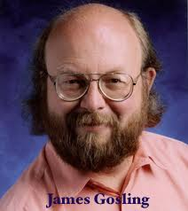
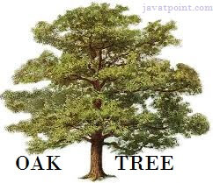
History of Java
1) James Gosling, Mike Sheridan, and Patrick Naughton initiated the Java language project in June 1991. The small team of sun engineers called Green Team.
2) Initially designed for small, embedded systems in electronic appliances like set-top boxes.
3) Firstly, it was called "Greentalk" by James Gosling, and the file extension was .gt.
4) After that, it was called Oak and was developed as a part of the Green project.
5) Since Oak was already a registered company, so James Gosling and his team changed the Oak name to Java

Slide 21
THANK YOU

